Slide 1
Automating apstra
Chris Marget
PLM, CRDC

Slide 2
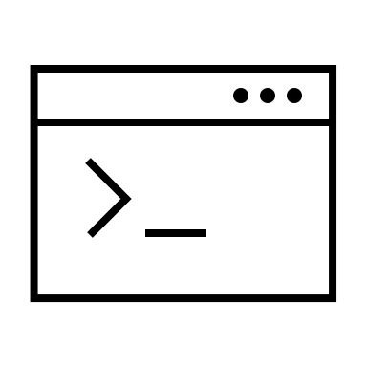

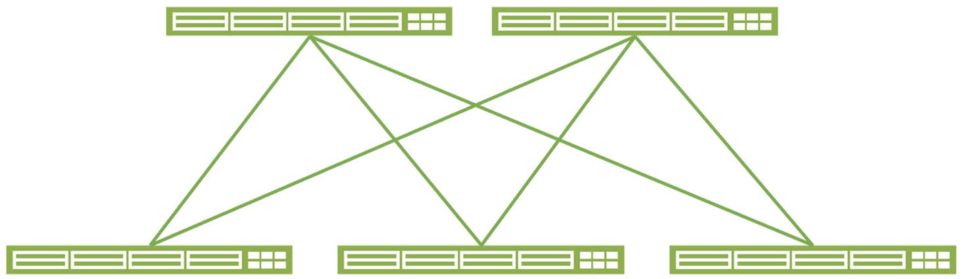
The dark ages
Lots of individual configurations
Written by a human (or script)
Pushed to lots of boxes
Usually with lots of mistakes

Slide 3



With Apstra:
Unifed interface
Browser
API
Focus on services offered by the fabric
Forget about the boxes in the fabric
Cloud Ready DC Fabric

Slide 4


Add Terraform:
Document and validate intent
Offline share/diff/policy review
Templating/repeatability/speed
Cloud Ready DC Fabric

Slide 5
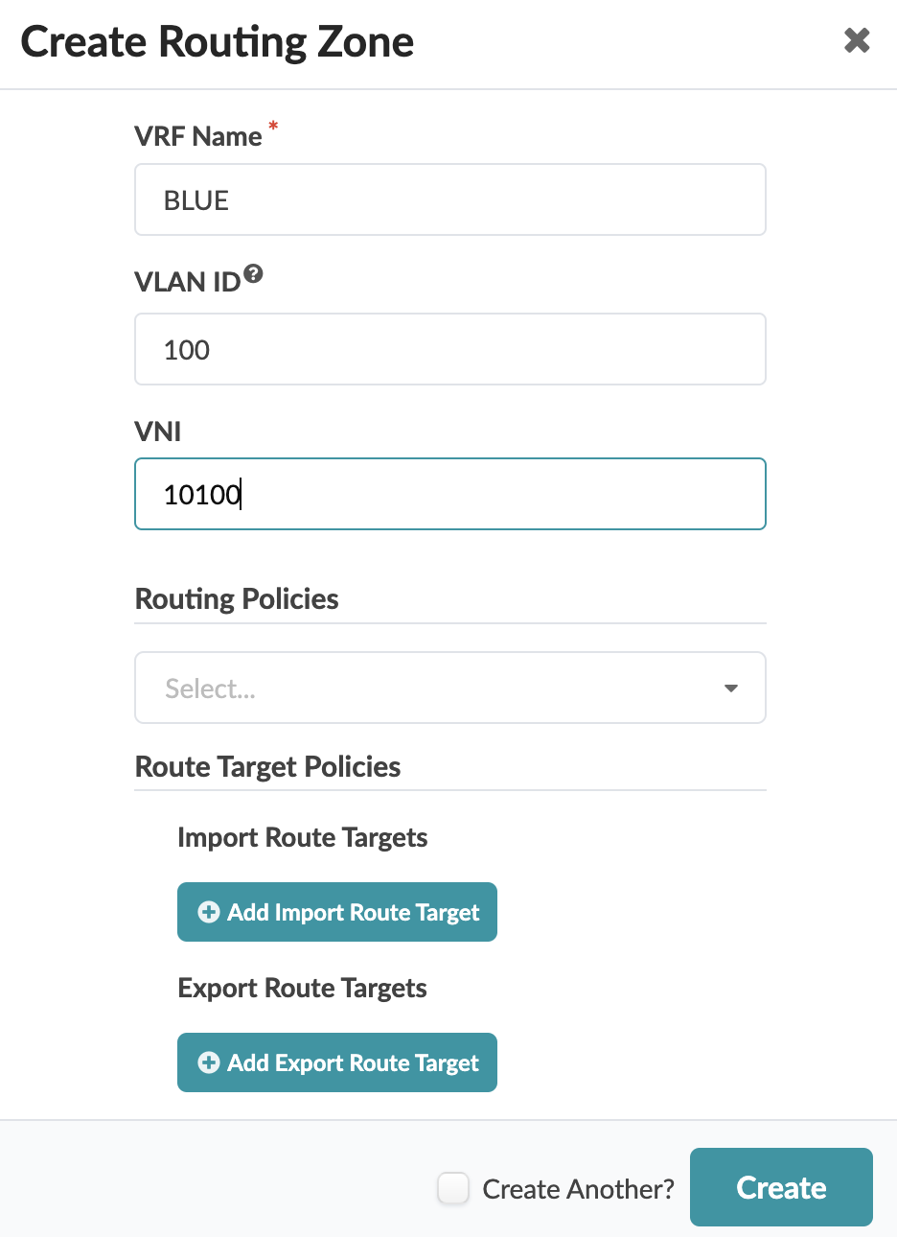
Create something new in Apstra:
Navigate to the correct blueprint
Click the “Create” button for desired object
Fill in some mandatory and optional fields

Slide 6
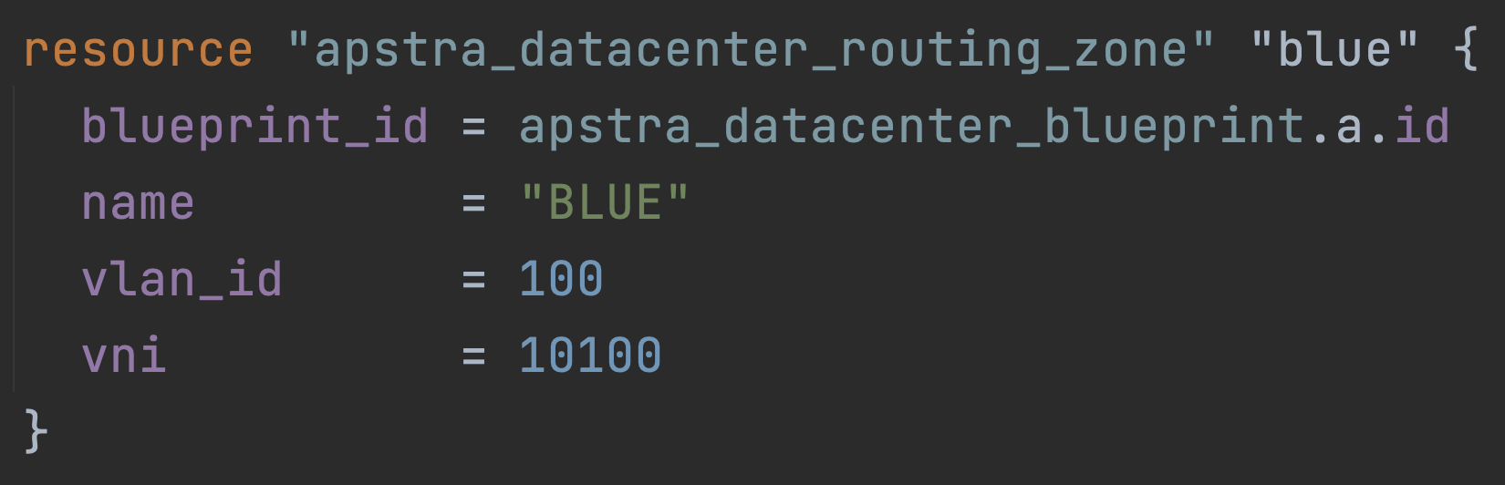
Create something new in Apstra with Terraform:
Declare an object of the desired type
Fill in some mandatory and optional fields

Slide 7
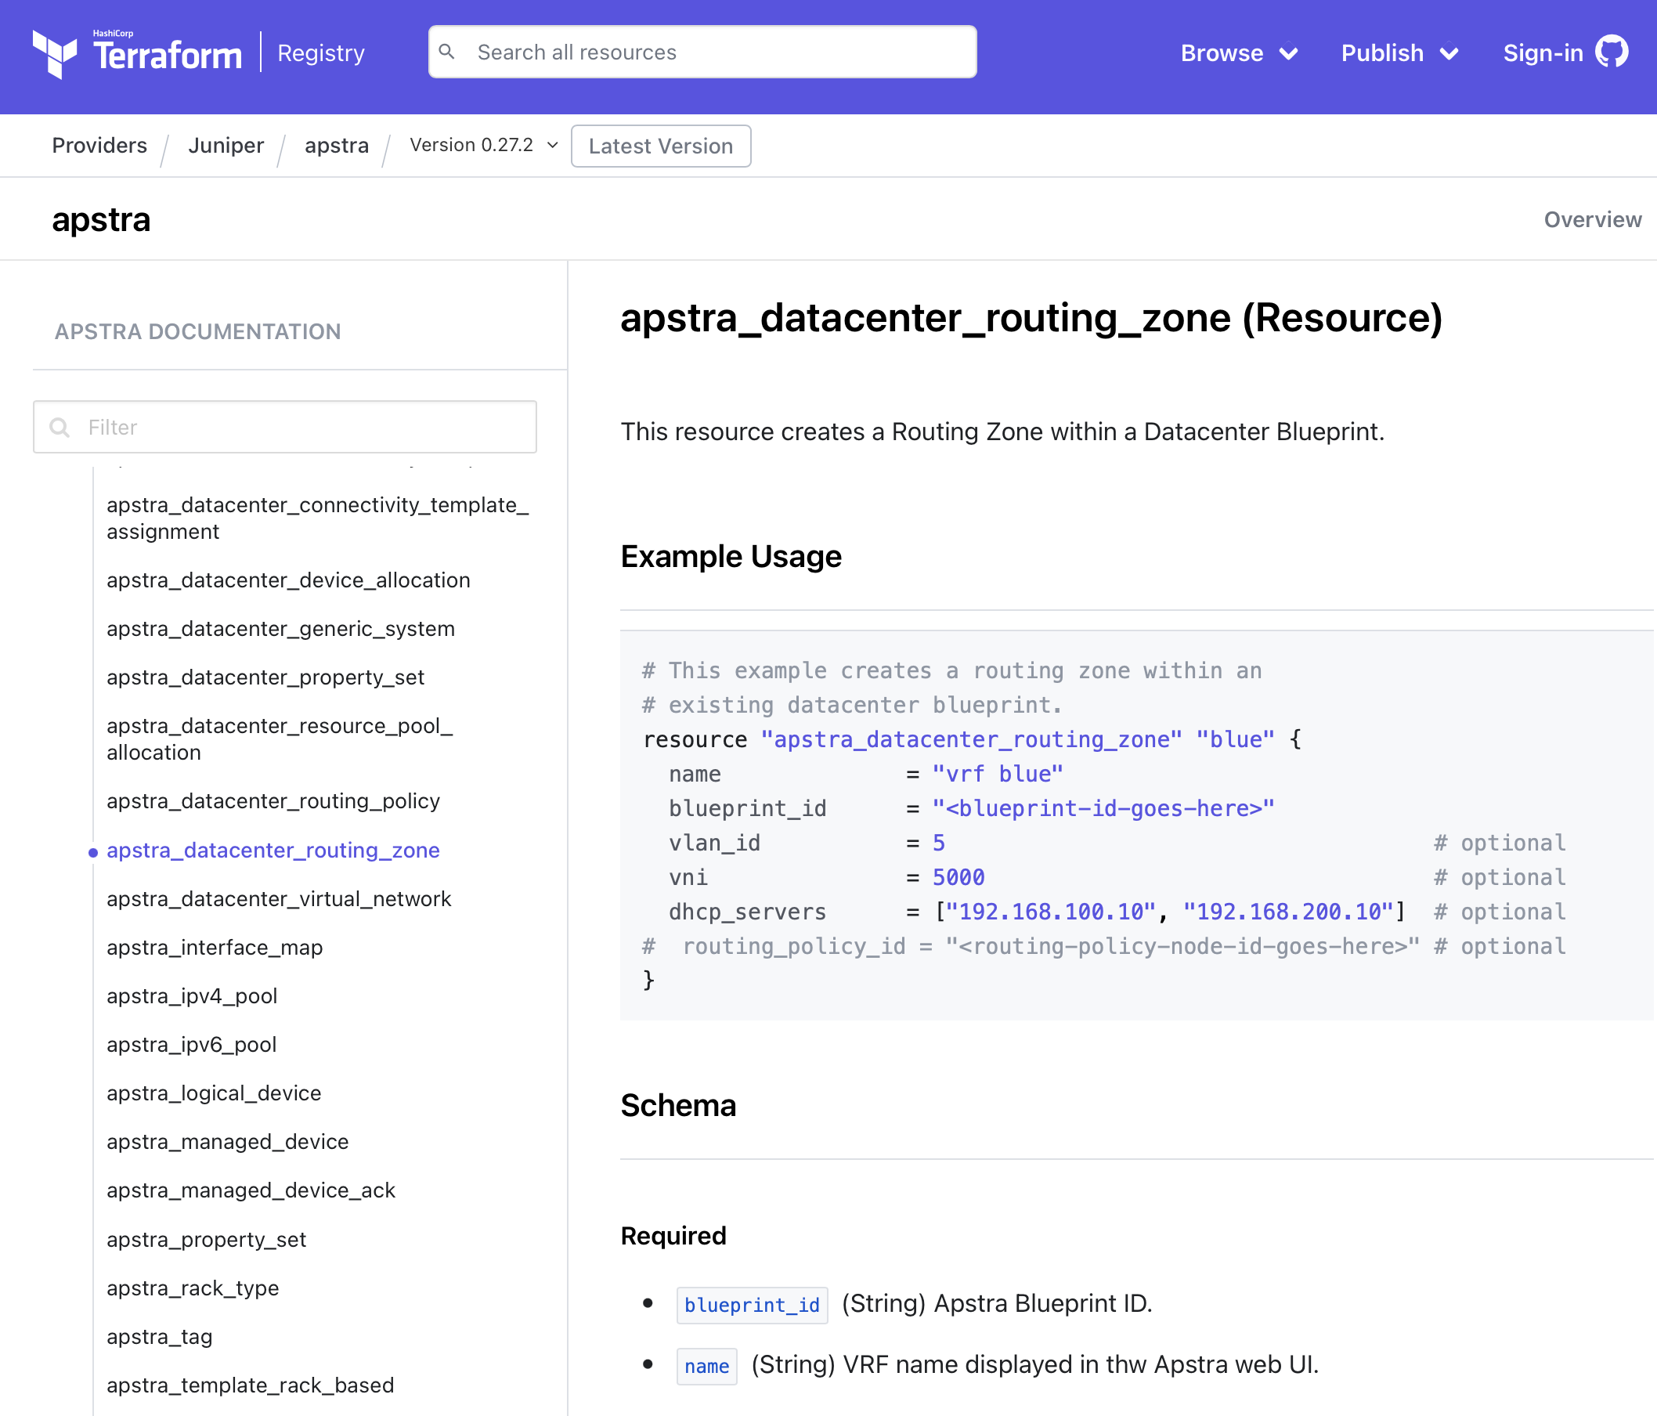

Slide 8
Cloud Ready DC Fabric

Slide 9
Where should we keep
these configurations?
Cloud Ready DC Fabric

Slide 10


Cloud Ready DC Fabric

Slide 11

Peer review
Testing
Validation
Compliance review
Actions
Cloud Ready DC Fabric

Slide 12
Peer review
Testing
Validation
Compliance review
Deploy!
Cloud Ready DC Fabric

Slide 13







Routing Polices
Applied at
Fabric Edge
Cloud Ready DC Fabric
VPN Router / Firewall
3rd Party
Partners
Vendors
Suppliers

Slide 14
This is well within the reach of enterprise ops
I showed 20 lines describing VPN policy requirements.
I didn’t show 135 lines of VPN policy automation:
Boilerplate terraform stuff
Discover blueprint and routing zone IDs
Create routing policies
Compose and create Connectivity Template
Redeploy 🚀 the Blueprint as needed

Slide 15
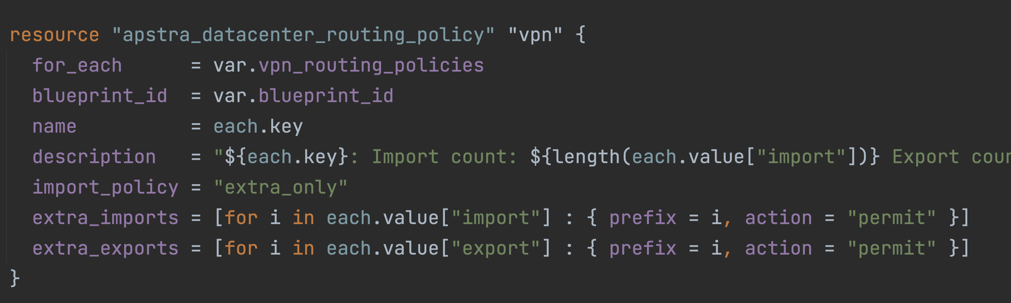

Slide 16
